Slide 1
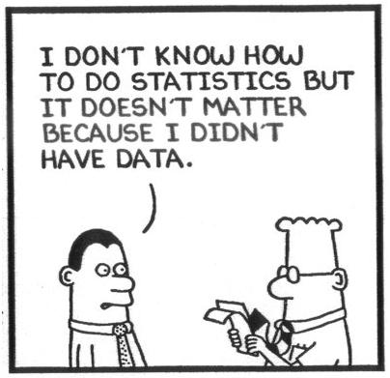
Measurement Error and Misclassification
EPI515 Fall 1
BST254 Fall
Lecture 4
Study Design in the Presence of Exposure Misclassification or Measurement Error
Updated 10.1.2016

Slide 2

Study design in the presence of misclassification
Fully validated design
Advantages: Easy to analyze, no questions about validity in terms
of transportability, form of the measurement error/misclassification
model
Disadvantages: May be unethical or unfeasible; even when not,
cost may be prohibitive
$$\{(D_{i},X_{i}),=1,...,n_{M}\}$$
2
Notes:
2

Slide 3
Main study/internal validation study design
Advantages: Guaranteed to be transportable, more efficient than
main study / external validation study
Disadvantages: Almost always needs to be planned in advance,
although there are exceptions
$$(D_{i},Z_{i}),i=1,...,n_{m};(D_{i},X_{i},Z_{i}),i=n_{m}+1,...,n_{m}+n_{v}$$
3
Notes:
3

Slide 4
Main study/external validation study design
Advantages: Often, the only option for valid analysis of studies in
which there is measurement error or misclassification
Disadvantages: Transportability may be questionable, and cannot
be empirically verified; less efficient than the main study/internal
validation study design
$$(D_{i},Z_{i}),i=1,...,n_{m};(X_{i},Z_{i}),i=n_{m}+1,...,n_{m}+n_{v}$$
4
Notes:
4

Slide 5






Two design problems are most important
a. Minimize the cost of the study as a function of ,
subject to a minimum acceptable power ( )
b. Maximize the power of the study as a function of ,
subject to a fixed total cost.
A closely related, but less useful, problem is
c. Minimize subject to a fixed total cost.
For a case-control study, is substituted with
$$(n_{m},n_{v})$$
$$π$$
$$(n_{m},n_{v})$$
$$Var(\hat{RR})$$
$$Var(\hat{RR})$$
$$Var(\hat{OR})$$
5
Notes:
5

Slide 6



Note that can be rewritten as ,
where
Greenland (Greenland, 1988) addressed problem (c) in detail for
case-control studies on the matrix method estimator, and, in his Appendix, provides the formulas to address problem (c) in cohort studies.
Greenland S. (1988) Statistical uncertainty due to misclassification- implications for validation
substudies. Journal Of Clinical Epidemiology 41:1167-1174.
$$(n_{m},n_{v})$$
$$(λ,n)$$
$$λ=\frac{n_{v}}{n_{v}+n_{m}}=\frac{n_{v}}{n}$$
6
Notes:
6

Slide 7










Greenland S. (1988)
To solve this problem for case-control studies, additional features of
the study must be specified. These include:
(Of course, it can be assumed that misclassification is
non-differential)
Or, although Greenland didn’t provide the formulas in these terms,
Bayes theorem can be used to solve for as a
function of , , and
Alternatively, the problem could be re-parameterized in terms of
and and the can be
solved for.
$$θ_{d}, d=0,1$$
$$φ_{d}, d=0,1$$
$$p_{d}=\operatorname{Pr}{(}X=1|D=d), d=0,1$$
$$\operatorname{Pr}{(}X=1|D=d)$$
$$\operatorname{Pr}{(}Z=1|D=d)$$
$$θ_{d}$$
$$φ_{d},d=0,1$$
$$\operatorname{Pr}{(}X=1)$$
$$OR,$$
$$\operatorname{Pr}{(}X=1|D=d),d=0,1,$$
7
Notes:
7

Slide 8
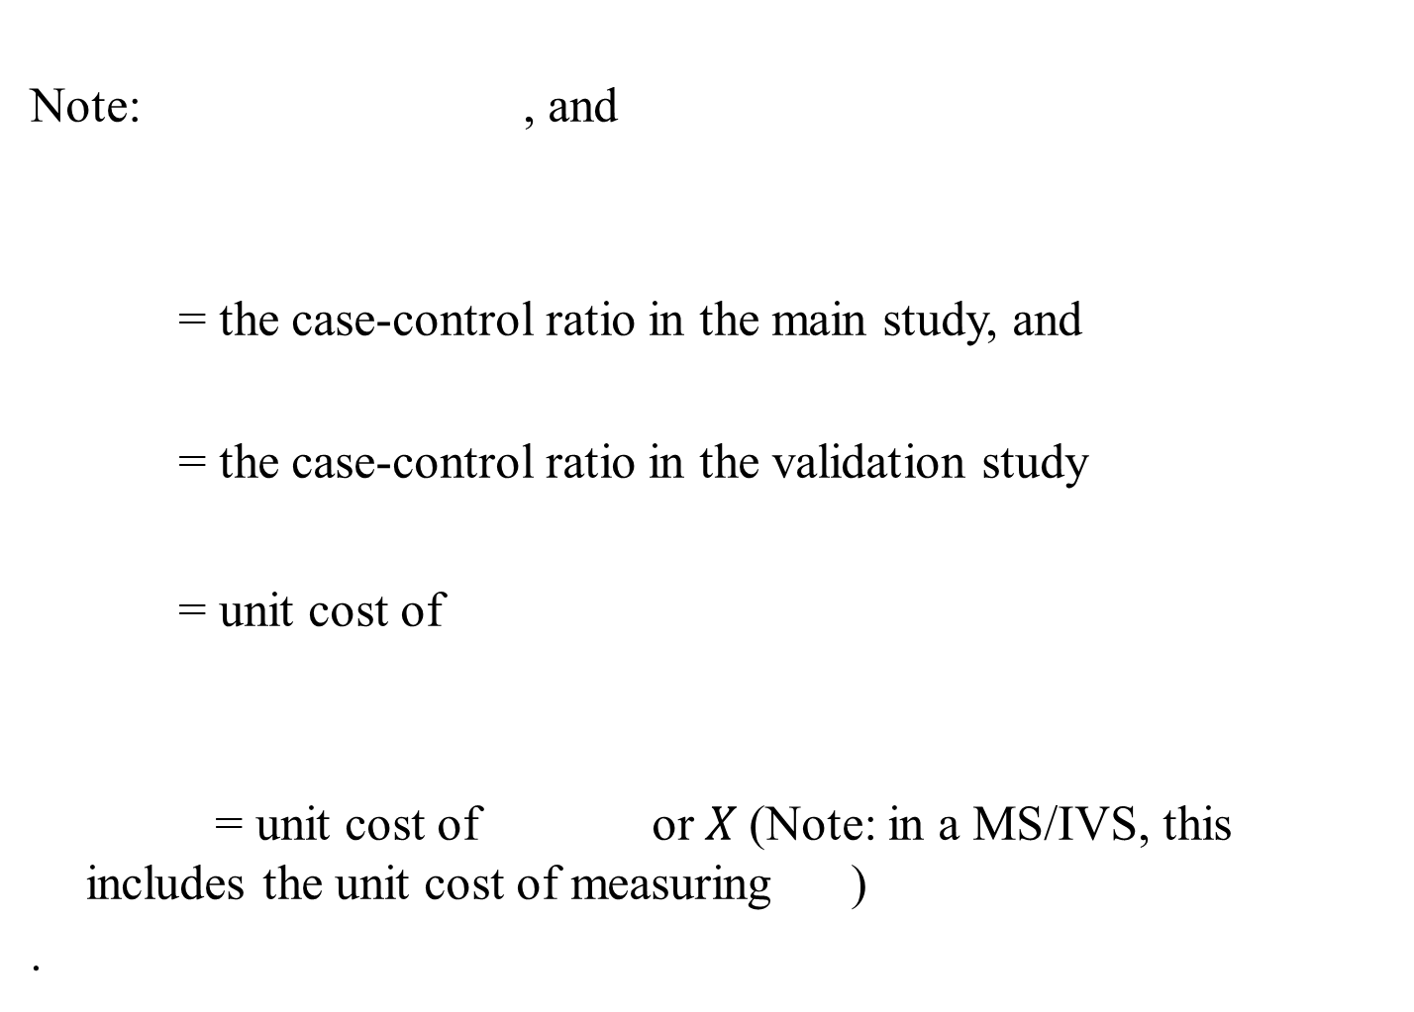








$$OR=\frac{p_{1}(1−p_{0})}{(1−p_{1})p_{0}}$$
$$κ_{m}$$
$$κ_{v}$$
$$r_{Z}$$
$$Z$$
$$r_{X}$$
$$X$$
$$D$$
Notes:
8

Slide 9



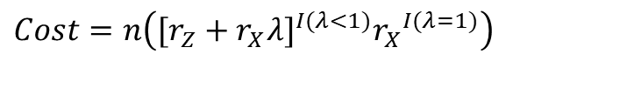






Greenland S. (1988)
Recall that is the odds ratio estimated in the validation study
without bias using data on , and is the
odds ratio from the matrix method. Then, in a MS/IVS, the solution to the problem:
subject to the constraint that
if primary measurement always necessary
Or if can be eliminated in fully validated design,
where and is used to find the value of
which gives the study design which provides the minimum variance
estimate of the odds ratio.
$${\hat{OR}}_{V}$$
$$(D_{i},X_{i}),i=n_{M}+1,...,n_{m}+n_{v}$$
$${\hat{OR}}_{M}$$
$$\underset{λ,n}{Min}\{Var[{\hat{OR}}_{M}(λ,n;θ_{1},θ_{0},φ_{1},φ_{0},p_{1},p_{0},κ_{m},κ_{v})],Var[{\hat{OR}}_{V}(n;p_{1},p_{0},κ_{v})]\}$$
$$Cost=n(r_{Z}+r_{X}λ)$$
$$Z$$
$$Cost=n\left([r_{Z}+r_{X}λ]^{I(λ<1)}{r_{X}}^{I(λ=1)}\right)$$
$$Z$$
$$λ∈(0,1]$$
$$n=n_{m}+n_{v}>1$$
$$(λ,n)$$
9
Notes:
9

Slide 10




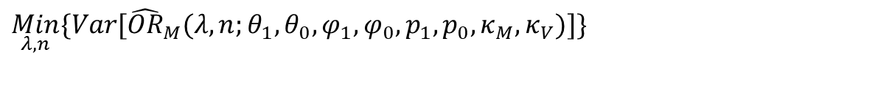

$$\operatorname{Pr}{(}Z=1|D=d)$$
Greenland S. (1988)
Note: The fully validated design is given by .
If the fully validated design isn’t an option for ethical or
feasibility reasons, the problem
subject to the constraint that ,
where and , can be solved to find the optimal
MS/IVS design.
$$λ=1$$
$$\underset{λ,n}{Min}\{Var[{\hat{OR}}_{M}(λ,n;θ_{1},θ_{0},φ_{1},φ_{0},p_{1},p_{0},κ_{M},κ_{V})]\}$$
$$Cost=n[r_{Z}+r_{X}λ]$$
$$λ∈(0,1)$$
$$n>1$$
10
Notes:
10

Slide 11















Table 4: Optimal proportion for validation substudy as a function of the cost ratio
(assuming parameter values equal values observed in the SIDS data)
$$λ_{opt}$$
$$R=r_{X}/r_{Z}$$
$$R$$
 | <=3 | 4 | 5 | 6 | 8 | 10
I. Assuming differential misclassification
A. Assuming primary measurement always necessary
 | 1.00 | 0.87 | 0.77 | 0.71 | 0.61 | 0.55
ARE at | 1.00 | 1.00 | 0.99 | 0.98 | 0.97 | 0.95
Relative | 1.00 | 0.90 | 0.81 | 0.75 | 0.65 | 0.59
B. Assuming primary measurement can be eliminated if
and ARE=1.00 for all R <=14
II. Assuming nondifferential misclassification
A. Assuming primary measurement always necessary
 | 1.00 | 0.11 | 0.07 | 0.06 | 0.04 | 0.04
ARE at | 1.00 | 0.90 | 0.80 | 0.72 | 0.60 | 0.52
Relative | 1.00 | 0.27 | 0.22 | 0.19 | 0.15 | 0.13
B. Assuming primary measurement can be eliminated if
 | 1.00 | 1.00 | 0.07 | 0.06 | 0.04 | 0.04
ARE at | 1.00 | 1.00 | 0.96 | 0.84 | 0.68 | 0.57
Relative | 1.00 | 1.00 | 0.27 | 0.23 | 0.16 | 0.14
* Asymptotic efficiency of design with , relative to design with . Ratio of study size when to study size when (assuming the same expenditure for measurement in both designs).
$$λ_{opt}$$
$$λ=1.0∗$$
$$N†$$
$$λ=1.0$$
$$λ_{opt}=1.00$$
$$λ_{opt}$$
$$λ=1.0$$
$$N$$
$$λ=1.0$$
$$λ_{opt}$$
$$λ=1.0$$
$$N$$
$$λ=1.0$$
$$λ=λ_{opt}$$
$$†$$
$$λ=1.0$$
$$λ=λ_{opt}$$
What is the relative cost of the measurement, , for your study?
For NHS, it has been estimated at 500.
$$R$$
11
Notes:
11

Slide 12








$$†$$
Assumes case-control ratios, and , are 1; all other parameters given by the SIDS data.
In case-control studies, with relatively low cost ratios (medical records vs. self-report), the fully validated design is often optimal
Differential vs. non-differential misclassification assumption has a big impact on the design.
$$κ_{M}$$
$$κ_{V}$$
12
Notes:
12

Slide 13
Reilly M. (1996)
Unlike Greenland’s development, which bases optimal design choices on
the matrix method estimator, this software uses the MLE assuming differential misclassification, and considers the MS/IVS design alone.
The criterion is to maximize precision for a fixed total budget or minimize the study cost given a desired precision.
It is known that with the MS/IVS design under differential misclassification, the MLE is equivalent to the inverse matrix method (Lyles, 2002) and that the efficiency loss from using the matrix method can be considerable.
Reilly M. (1996) Optimal sampling strategies for two-stage studies. American Journal of
Epidemiology 143:92-100.
Lyles R.H. (2002) A note on estimating crude odds ratios in case-control studies with differentially
misclassified exposure. Biometrics 58:1034-1036.
13
Notes:
13

Slide 14



More complex designs have been developed in which the
validation study proportions vary by , , and even
(Reilly, 1996; Tosteson and Ware, 1990) and others.
They have rarely if ever been used in practice.
Tosteson T.D., Ware J.H. (1990) Designing a logistic regression study using surrogate measures for
exposure and outcome. Biometrika 77:11-21.
$$Z$$
$$D$$
$$(Z,D)$$
14
Notes:
14

Slide 15


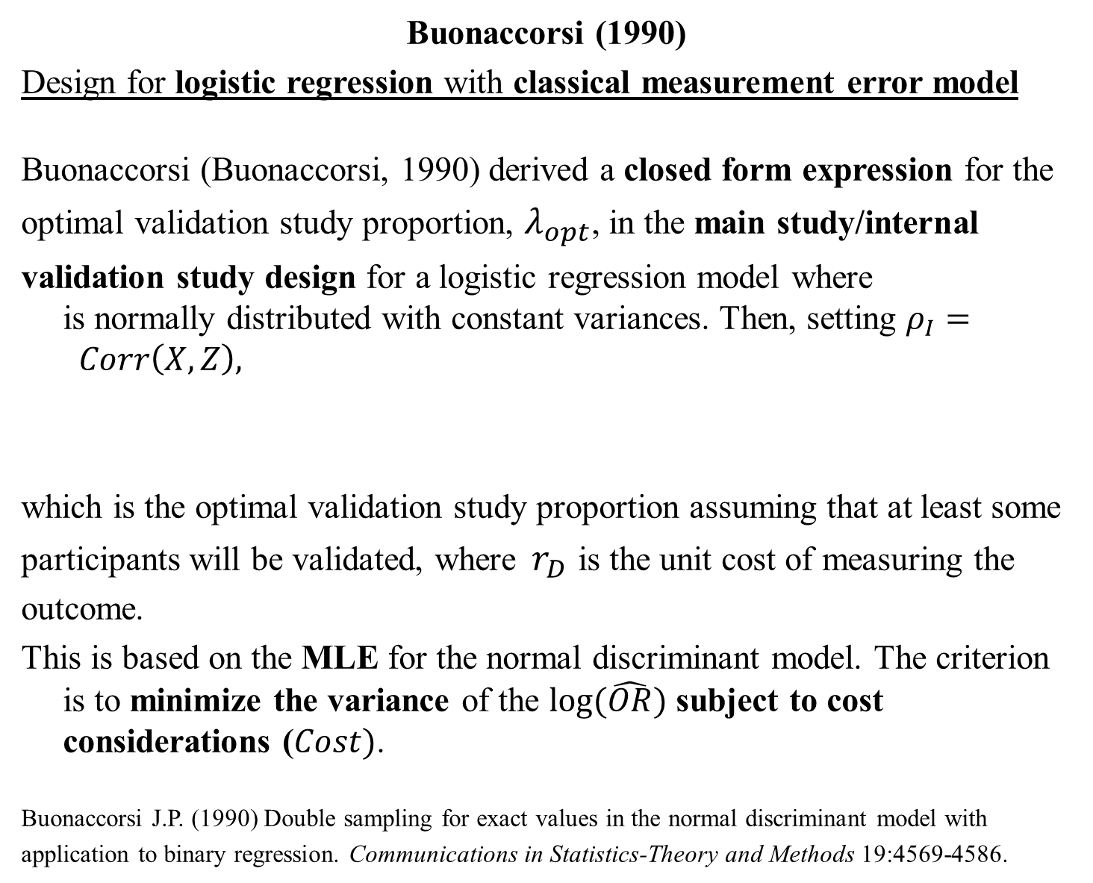
Buonaccorsi (1990)
Design for logistic regression with classical measurement error model
Buonaccorsi (Buonaccorsi, 1990) derived a closed form expression for the
optimal validation study proportion, $λ_{opt}$, in the main study/internal
validation study design for a logistic regression model where is normally distributed with constant variances. Then, setting $ρ_{I}= Corr\left(X,Z\right),$
which is the optimal validation study proportion assuming that at least some
participants will be validated, where${ r}_{D}$ is the unit cost of measuring the
outcome.
This is based on the MLE for the normal discriminant model. The criterion is to minimize the variance of the $log⁡(\hat{OR})$ subject to cost considerations ($Cost)$.
Buonaccorsi J.P. (1990) Double sampling for exact values in the normal discriminant model with
application to binary regression. Communications in Statistics-Theory and Methods 19:4569-4586.
$$X,Z|D$$
${λ^{∗}}^{}=\min{(}1,{\left(\left[\frac{r_{D}+r_{Z}}{r_{X}}\right]\left[\frac{1+2Corr^{2}(D,X)−ρ_{I}−2Corr^{2}(D,X){ρ_{I}}^{2}}{ρ_{}+2Corr^{2}(D,X){ρ_{I}}^{2}}\right]\right)}^{1/2})$,
15
Notes:
15

Slide 16
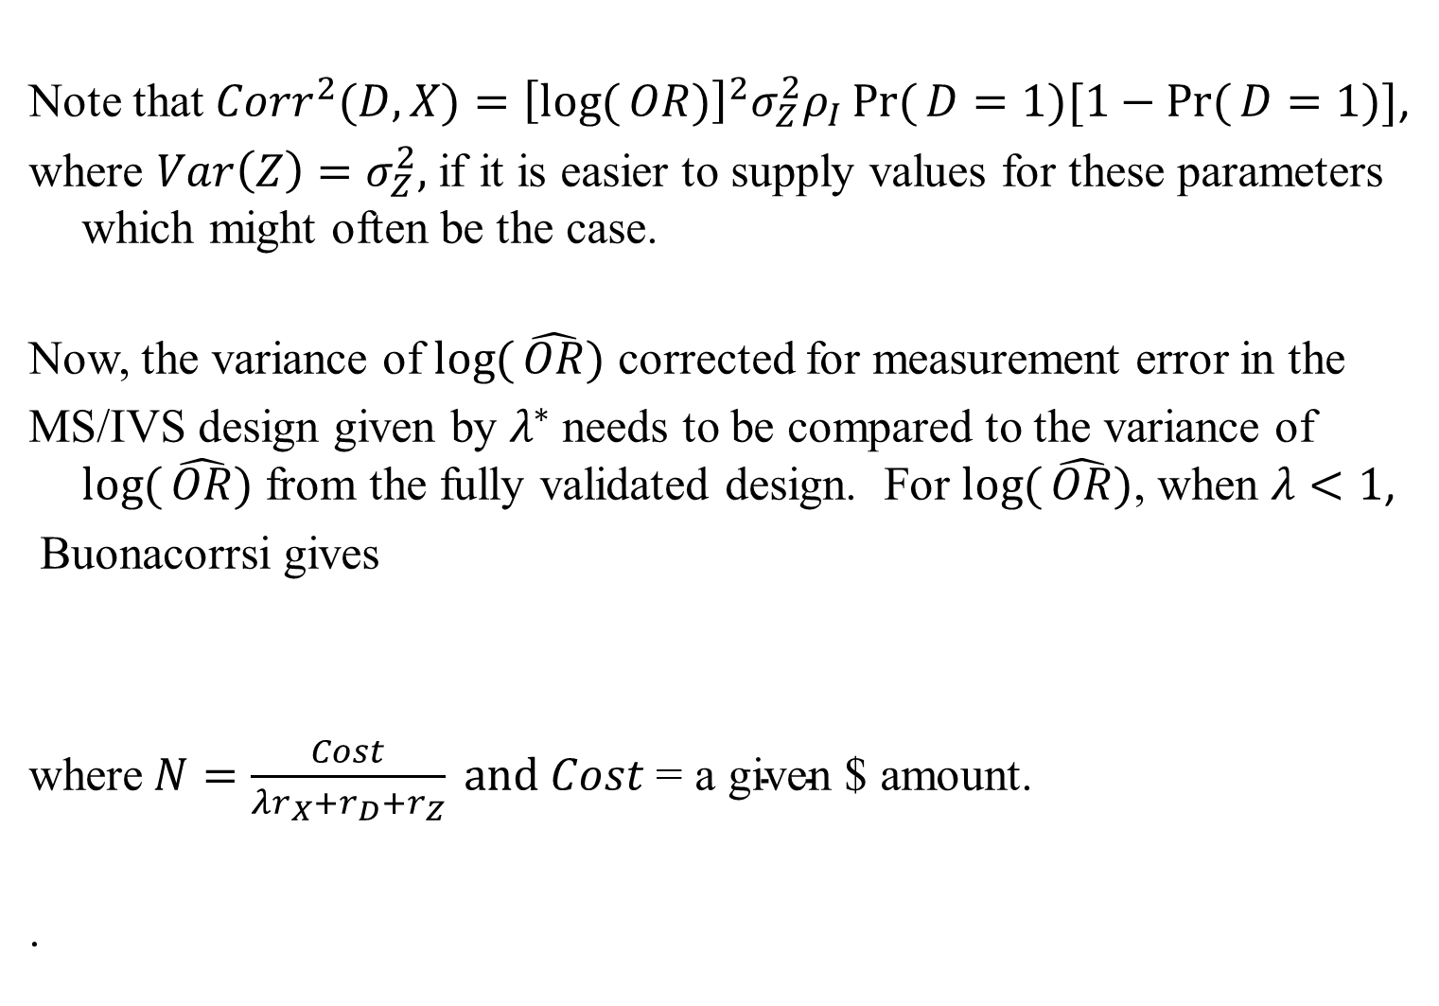
Note that $Corr^{2}(D,X)={\left[\log{(}OR)\right]}^{2}σ_{Z}^{2}ρ_{I}\operatorname{Pr}{(}D=1)[1−\operatorname{Pr}{(}D=1)]$,
where $Var\left(Z\right)=σ_{Z}^{2},$if it is easier to supply values for these parameters which might often be the case.
Now, the variance of $\log{(}\hat{OR})$ corrected for measurement error in the
MS/IVS design given by $λ^{∗}$needs to be compared to the variance of $\log{(}\hat{OR})$ from the fully validated design. For $\log{(}\hat{OR})$, when $λ<1$,
Buonacorrsi gives
where$N=\frac{Cost}{λr_{X}+r_{D}+r_{Z}} and Cost \text{= }\text{a} \text{given}\text{ \$}$ amount.
.
16
Notes:
16

Slide 17
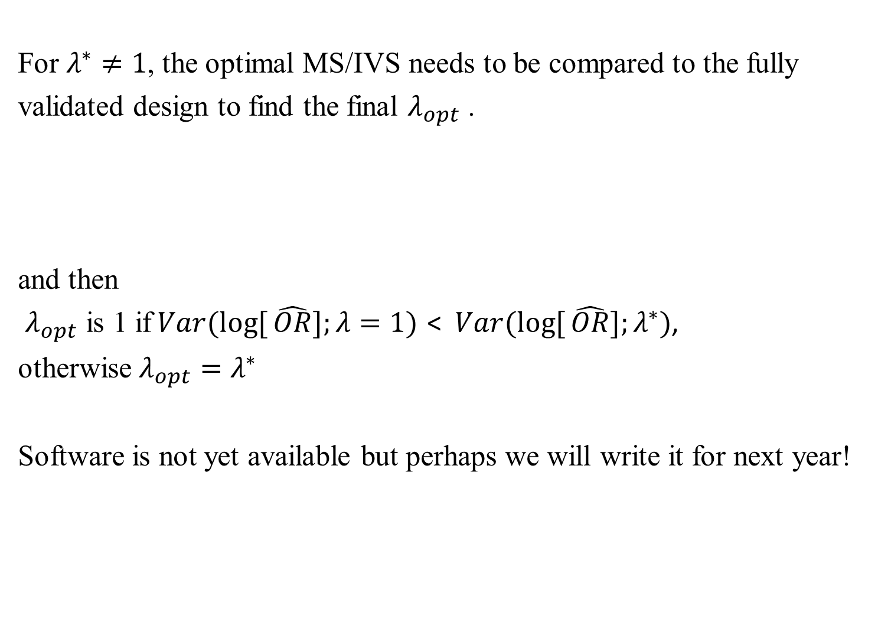
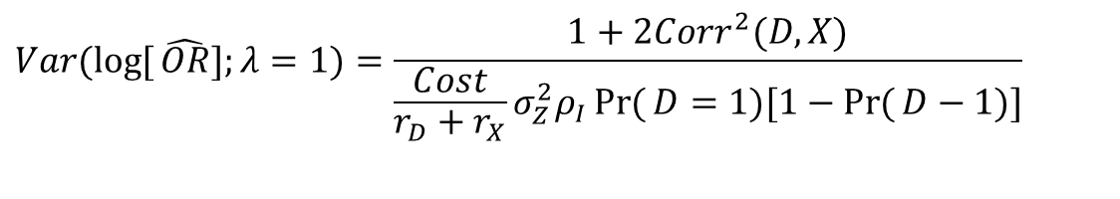
For $λ^{∗}≠1$, the optimal MS/IVS needs to be compared to the fully
validated design to find the final $λ_{opt}$ .
and then
$λ_{opt}$ is 1 if$Var(\log{[}\hat{OR}];λ=1)$ < $Var(\log{[}\hat{OR}];λ^{∗})$,
otherwise $λ_{opt}=λ^{∗}$
Software is not yet available but perhaps we will write it for next year!
$$Var(\log{[}\hat{OR}];λ=1)=\frac{1+2Corr^{2}(D,X)}{\frac{Cost}{r_{D}+r_{X}}σ_{Z}^{2}ρ_{I}\operatorname{Pr}{(}D=1)[1−\operatorname{Pr}{(}D−1)]}$$
17
Notes:
17

Slide 18
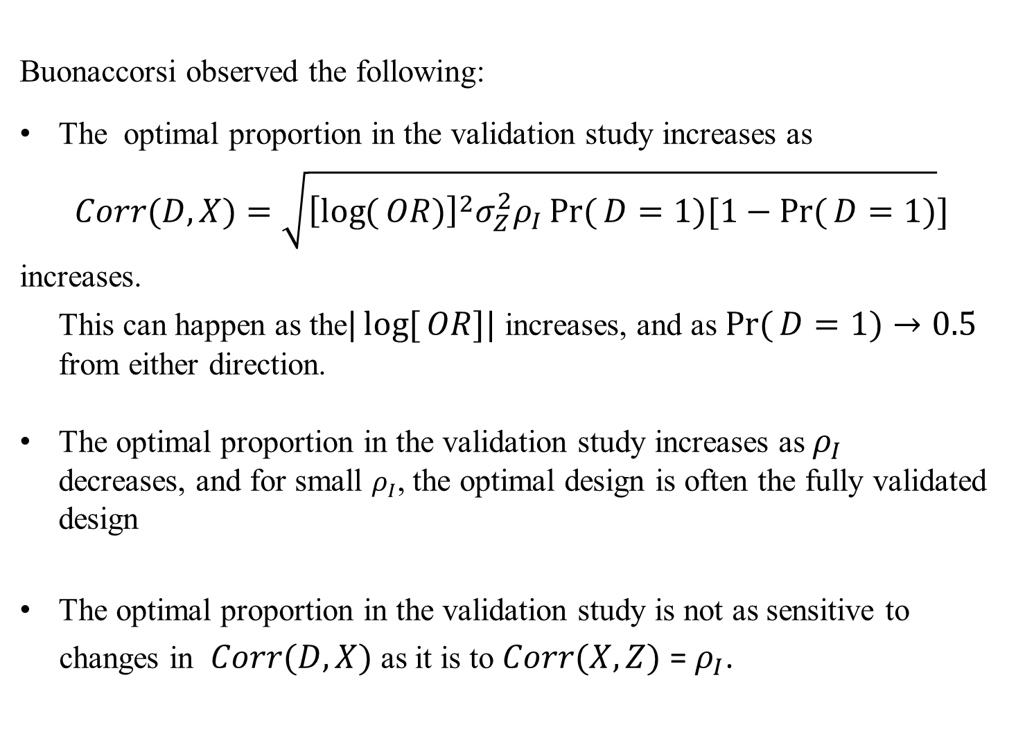
Buonaccorsi observed the following:
The optimal proportion in the validation study increases as
$$Corr(D,X)=\sqrt{{\left[\log{(}OR)\right]}^{2}σ_{Z}^{2}ρ_{I}\operatorname{Pr}{(}D=1)[1−\operatorname{Pr}{(}D=1)}]$$
increases.
This can happen as the$|\log{[}OR]|$ increases, and as${\operatorname{Pr}{(}D=1)→0.5}_{}$ from either direction.
The optimal proportion in the validation study increases as $ρ_{I}$ decreases, and for small $ρ_{I}$, the optimal design is often the fully validated design
The optimal proportion in the validation study is not as sensitive to
changes in $Corr(D,X)$ as it is to $Corr(X,Z)$ = $ρ_{I}$.
18
Notes:
18

Slide 19

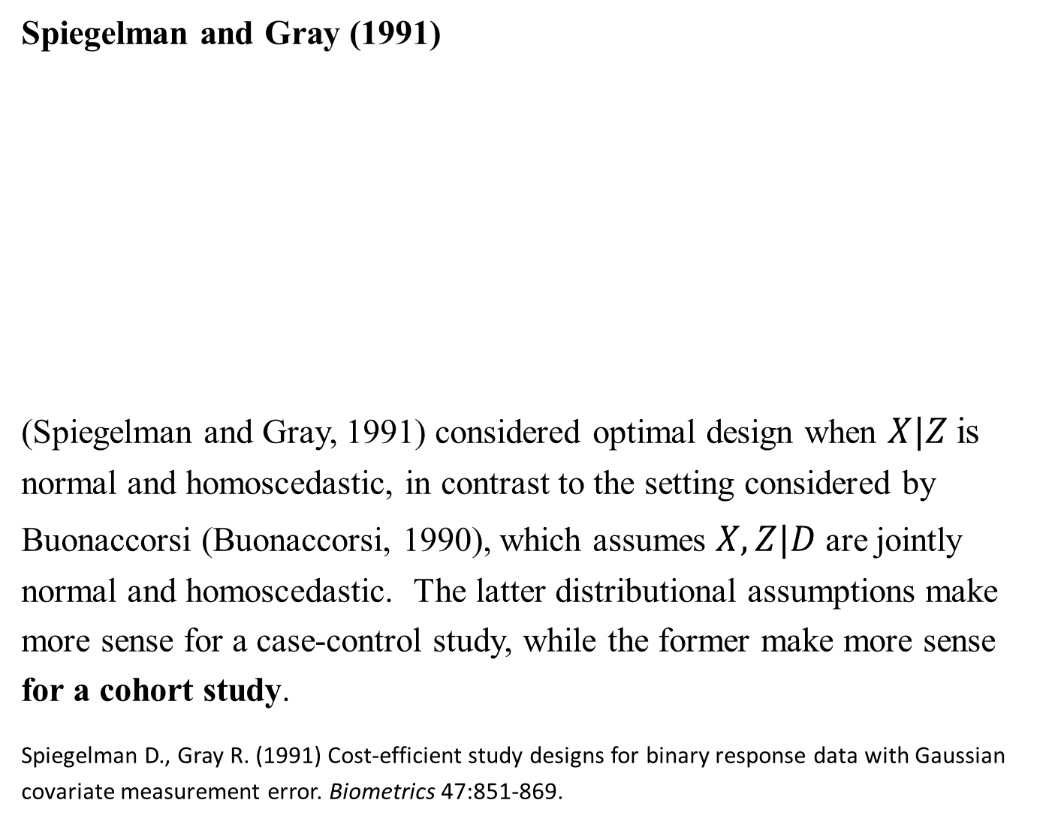


Spiegelman and Gray (1991)
(Spiegelman and Gray, 1991) considered optimal design when $X|Z$ is
normal and homoscedastic, in contrast to the setting considered by
Buonaccorsi (Buonaccorsi, 1990), which assumes $X,Z|D$ are jointly
normal and homoscedastic. The latter distributional assumptions make
more sense for a case-control study, while the former make more sense
for a cohort study.
Spiegelman D., Gray R. (1991) Cost-efficient study designs for binary response data with Gaussian
covariate measurement error. Biometrics 47:851-869.
$$X|Z$$
$$X,Z|D$$
19
Notes:
19

Slide 20
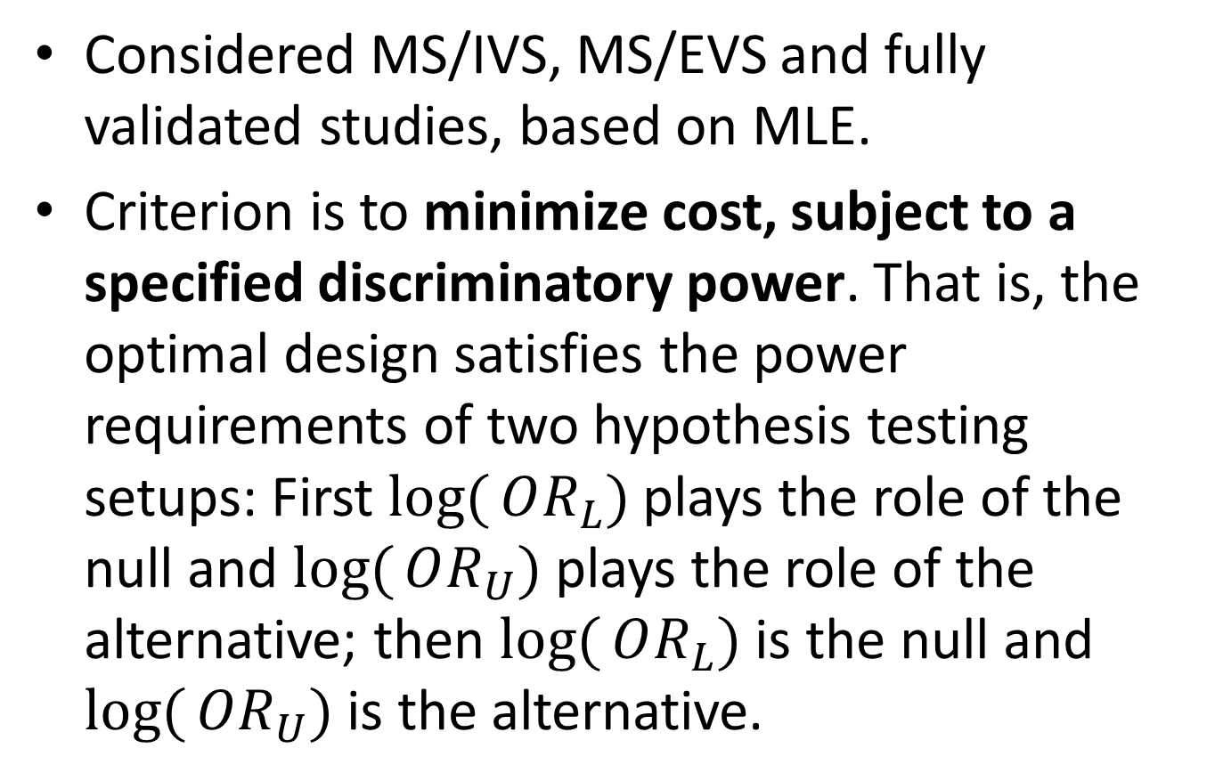
Spiegelman and Gray (1991)
Considered MS/IVS, MS/EVS and fully validated studies, based on MLE.
Criterion is to minimize cost, subject to a specified discriminatory power. That is, the optimal design satisfies the power requirements of two hypothesis testing setups: First $\log{(}OR_{L})$plays the role of the null and $\log{(}OR_{U})$ plays the role of the alternative; then $\log{(}OR_{L})$ is the null and $\log{(}OR_{U})$ is the alternative.

Slide 21

Discriminatory power
Power to discriminate two parameter values.
Let and be the two values that we want to discriminate, and let (e, f) be the 95% CI for log(OR). Then, the power to discriminate and is the smaller of
and .
Since
, it has one side type I error rate of 2.5% for each direction.
Greenland S. On Sample-Size and Power Calculations for Studies Using Confidence Intervals. AJE 1988; 128, 231-235.
$$\log{(}OR_{U})$$

Slide 22
Discriminatory power
(e f) ----standard
(e f) ----additional
A sample size may be considered adequate for discriminating between two parameter values (one of which is correct), if it is large enough so that there is a good chance that the observed CI excludes the incorrect value.

Slide 23
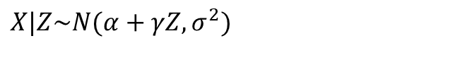
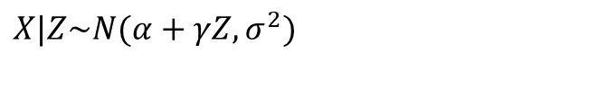

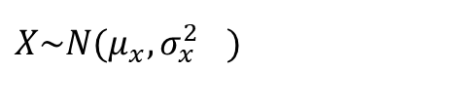
Spiegelman and Gray (1991)
It assumes measurement error model:
Recall that if , classical measurement error
can be written as with
$$X|Z\sim N(α+γZ,σ^{2})$$
$$X\sim N(μ_{x},{σ_{x}^{2}}^{})$$
$$Z=X+ε,ε\sim N(0,σ_{ε}^{2})$$
$$X|Z\sim N(α+γZ,σ^{2})$$
$$α=(1−ρ_{I})μ_{x},γ=ρ_{I},σ^{2}=(1−ρ_{I})σ_{x}^{2}.$$

Slide 24








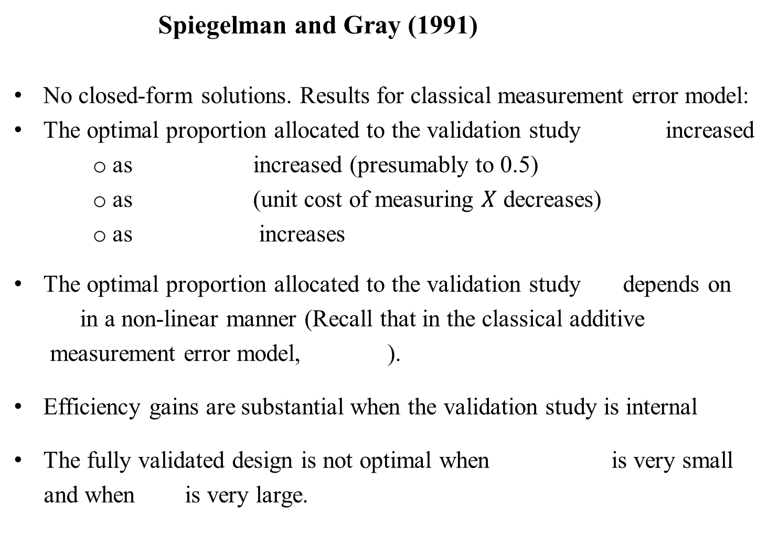

Spiegelman and Gray (1991)
No closed-form solutions. Results for classical measurement error model:
The optimal proportion allocated to the validation study increased
as increased (presumably to 0.5)
as (unit cost of measuring $X$ decreases)
as increases
The optimal proportion allocated to the validation study depends on
in a non-linear manner (Recall that in the classical additive
measurement error model, ).
Efficiency gains are substantial when the validation study is internal
The fully validated design is not optimal when is very small
and when is very large.
$$\left(λ_{opt}\right)$$
$$\operatorname{Pr}{(}D=1)$$
$$r_{X}→r_{Z}$$
$$|\log{(}OR)|$$
$$λ$$
$$γ$$
$$γ=ρ_{I}$$
$$\operatorname{Pr}{(}D=1)$$
$$r_{X}$$
24
Notes:
24

Slide 25
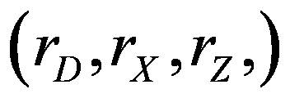




In this figure, and under classical measurement error model for MS/EVS design.
$$λ_{opt}$$
$$λ_{opt}$$
$$\operatorname{Pr}{(}D=1)=0.005$$
$$X\sim N(0,1)$$
25
Notes:
25

Slide 26


Rosner, Spiegelman and Willett (Rosner et al., 1992)
Rosner, Spiegelman and Willett (Rosner et al., 1992) investigated
the role of (size of reliability study) and (number of replicates per participant in the reliability study) on the efficiency of the regression calibration estimates for the effects of systolic blood pressure (SBP), serum cholesterol (CHOL), serum glucose (GLUC) and BMI on the 10-year cumulative incidence of CHD, based on the Framingham Heart Study. There were 1,731 men in the main study cohort.
Rosner B., Spiegelman D., Willett W.C. (1992) Correction of logistic regression relative risk
estimates and confidence intervals for random within-person measurement error. Am J Epidemiol
136:1400-13.
$$n_{R}$$
$$n_{R_{I}}$$
26
Notes:
26

Slide 27









It is apparent that as increases,
the variances of the measurement
error corrected log relative risks
using regression calibration converge to an asymptote.
At small values of , larger
values of improve the
precision, but once is greater
than 100 or so, there is very little
advantage over .
$$n_{R}$$
$$n_{R}$$
$$n_{R_{I}}$$
$$n_{R}$$
$$n_{R_{I}}=2$$
$$n_{R_{I}}=2$$
$$n_{R_{I}}=3$$
$$n_{R_{I}}=5$$
$$n_{R_{I}}=10$$
27
Notes:
27

Slide 28
Concepts
Fully validated design
Optimal design
Unit cost
28
Notes:
28

